Slide 1

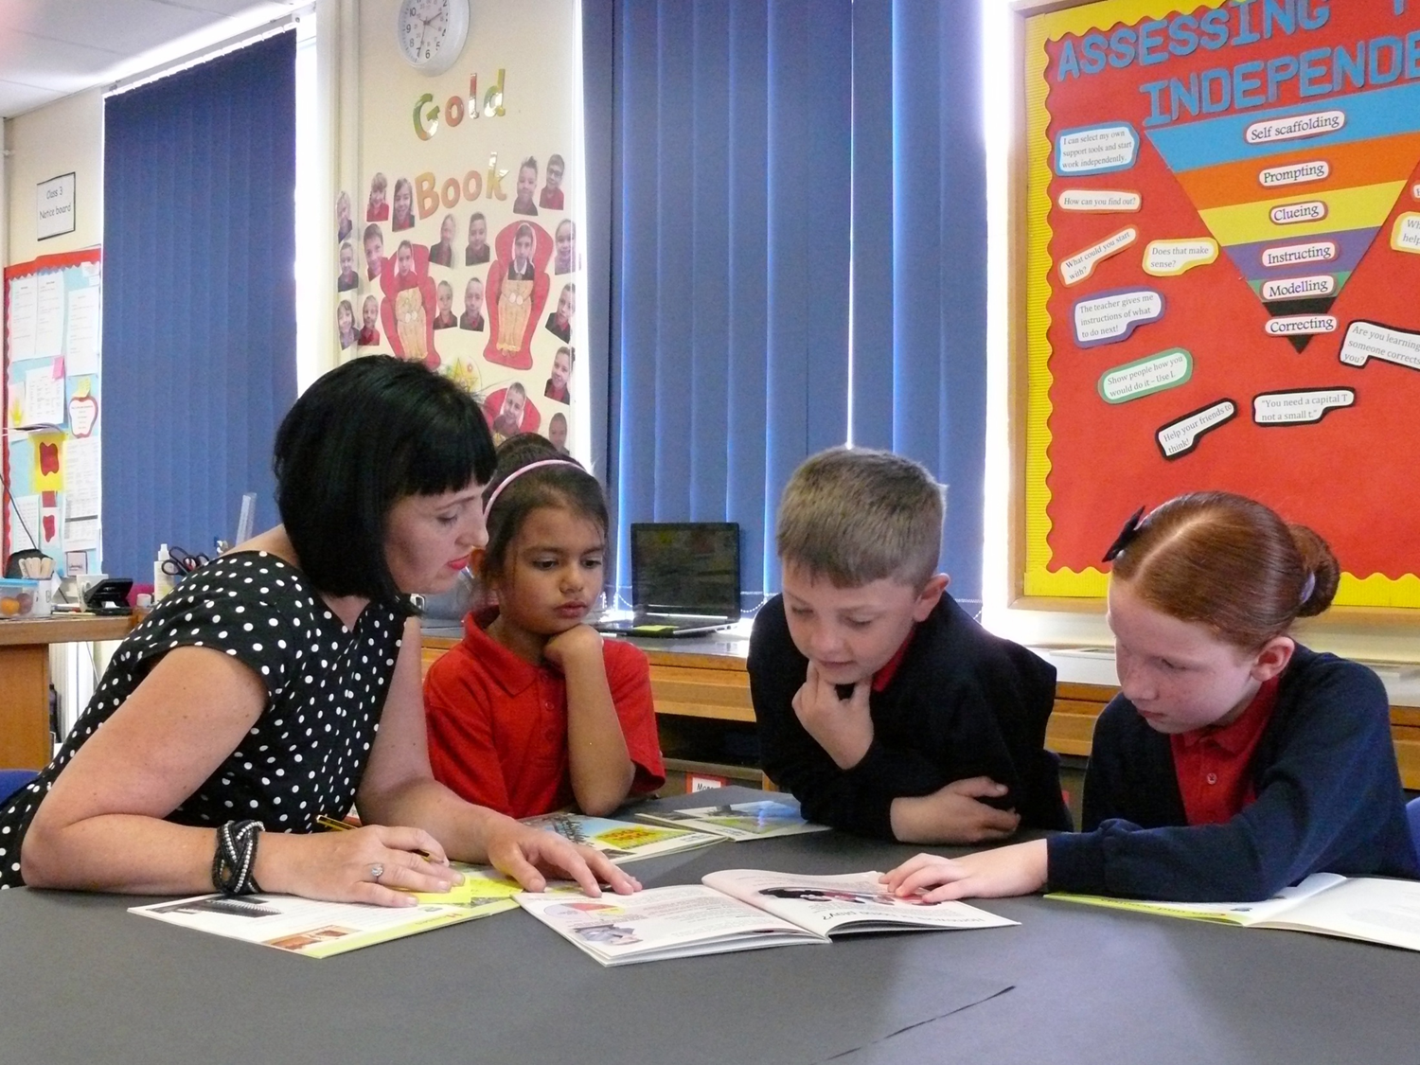

Maximising the Practice of TAs
What teachers need to know
Sally Franklin
Based on the book The Teaching Assistant’s Guide to Effective Interaction: How to Maximise your Practice
by Paula Bosanquet, Julie Radford & Rob Webster

Slide 2
Coverage for today
Summarising latest research and guidance on use and impact of TAs: what does and does not work
Guidance on the complementary roles of teachers and TAs
Scaffolding as a framework for developing student independence
Next steps: putting the strategies into action

Slide 3
Our TA workforce in numbers
£5
billion per year
The rise and rise of TAs (FTE):
      2000 = 53,400 (19% of primary workforce)
      2005 = 97,900 (29%)
      2010 = 126,300 (32%)
      2012 = 146,700 (33%)
      2014 = 166,200 (34%)
      2016 = 277,700 (35%)
      2021 = 298,000
      2024 = 400,000+
91% primary TAs work part-time
#1 Pupil Premium spend
£18,000
per TA per year
£186,000
average primary spend per year
Notes:
So, just to think about the contextual issues that surround the TA role… why this project and why is it something that is so important for schools at the moment? Well, I think it’s fair to say that most of you would agree that the SEND landscape has changes considerably in the last 10 years or so, as we see a reduction in spcialist places available, an increase in EHCP applications, and an increase in the number of pupils with more complex needs in mainstream schools. Our response to that in many ways, is met by the role of support staff and so it becomes increasingly important to understand that role and how it’s supported across schools. This is a workforce that has trebled in the last 15 years – number one in terms of pupil premium spend, and arguably a role that has changed considerably during that time. Long gone are the days when you might be asking TAs to put up a display or wash out paint pots and oncreasingly we’re asking TAs to take on a direct instructional teaching role, leading from the front of the class, working with pupils with complex needs, run inyerventions and so on. I think probably all of you listening to be now would agree that TAs are key to schools being able to run in the way they do and that tehir support is invaluable to you as a teacher. And so, budgets are stretched, recruitment and retention is difficult and the needs of pupils increases, and so it becomes important to consider the complementary roles that teachers and TAs play. Which is why we’re here today…

Slide 4
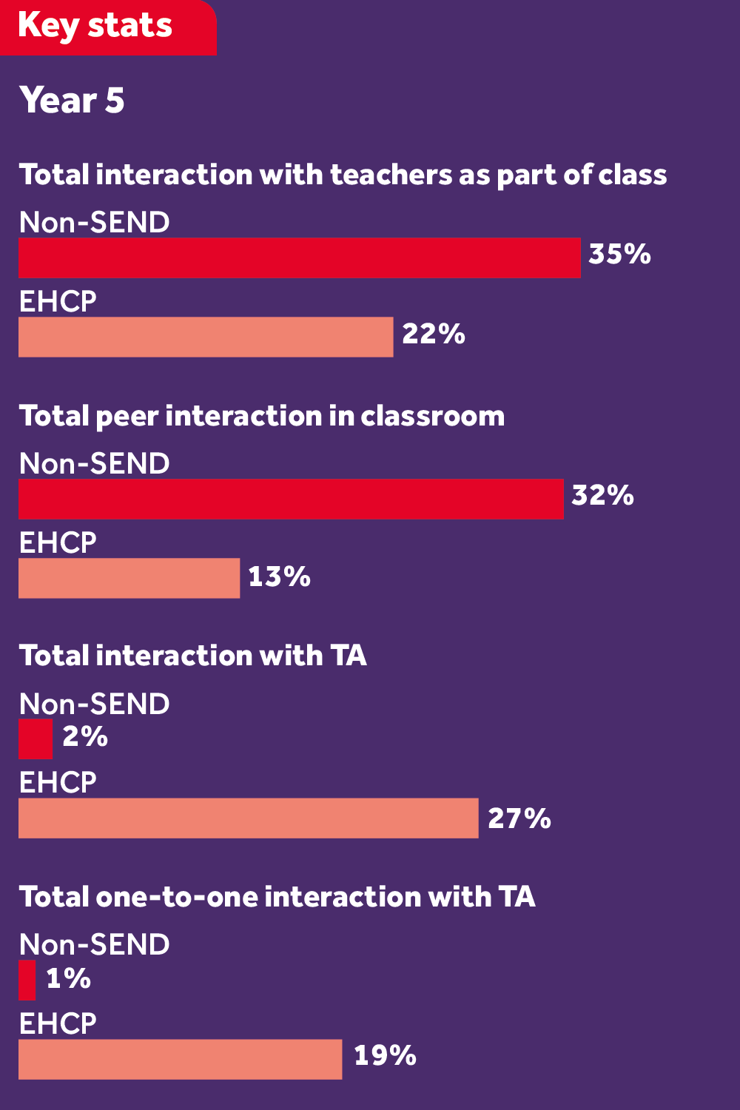
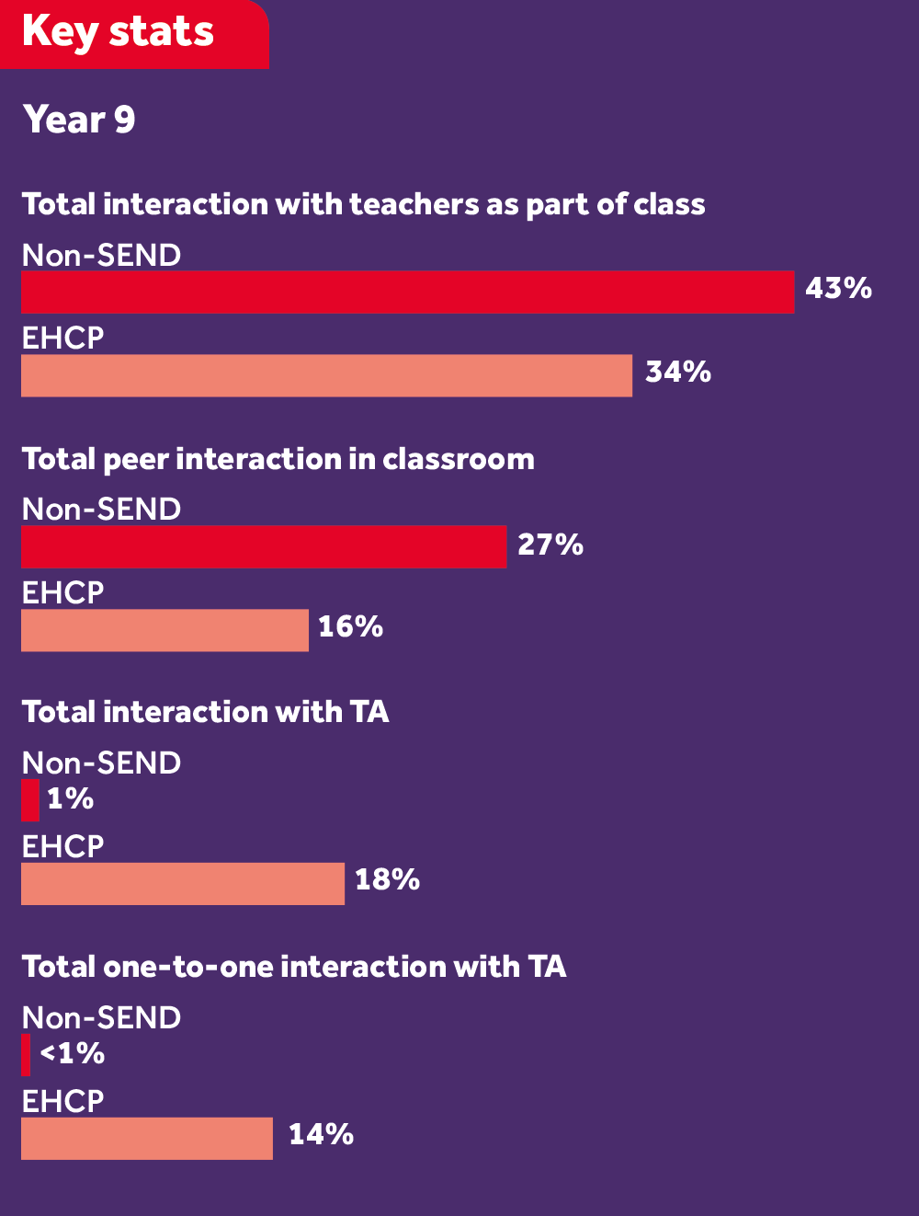
The separation effect for pupils with EHCPs
Source: The myth of inclusion, TES, 30 June 2017
maximisingtas.co.uk/research/research-blogs-articles.php

Slide 5
What research tells us
Good evidence that pupils make progress in literacy and numeracy as a result of structured interventions delivered by TAs (Sharples, 2016; Slavin, 2016)
The situation is different in relation to pupils who receive classroom based support (Webster et al., 2012)

Slide 6
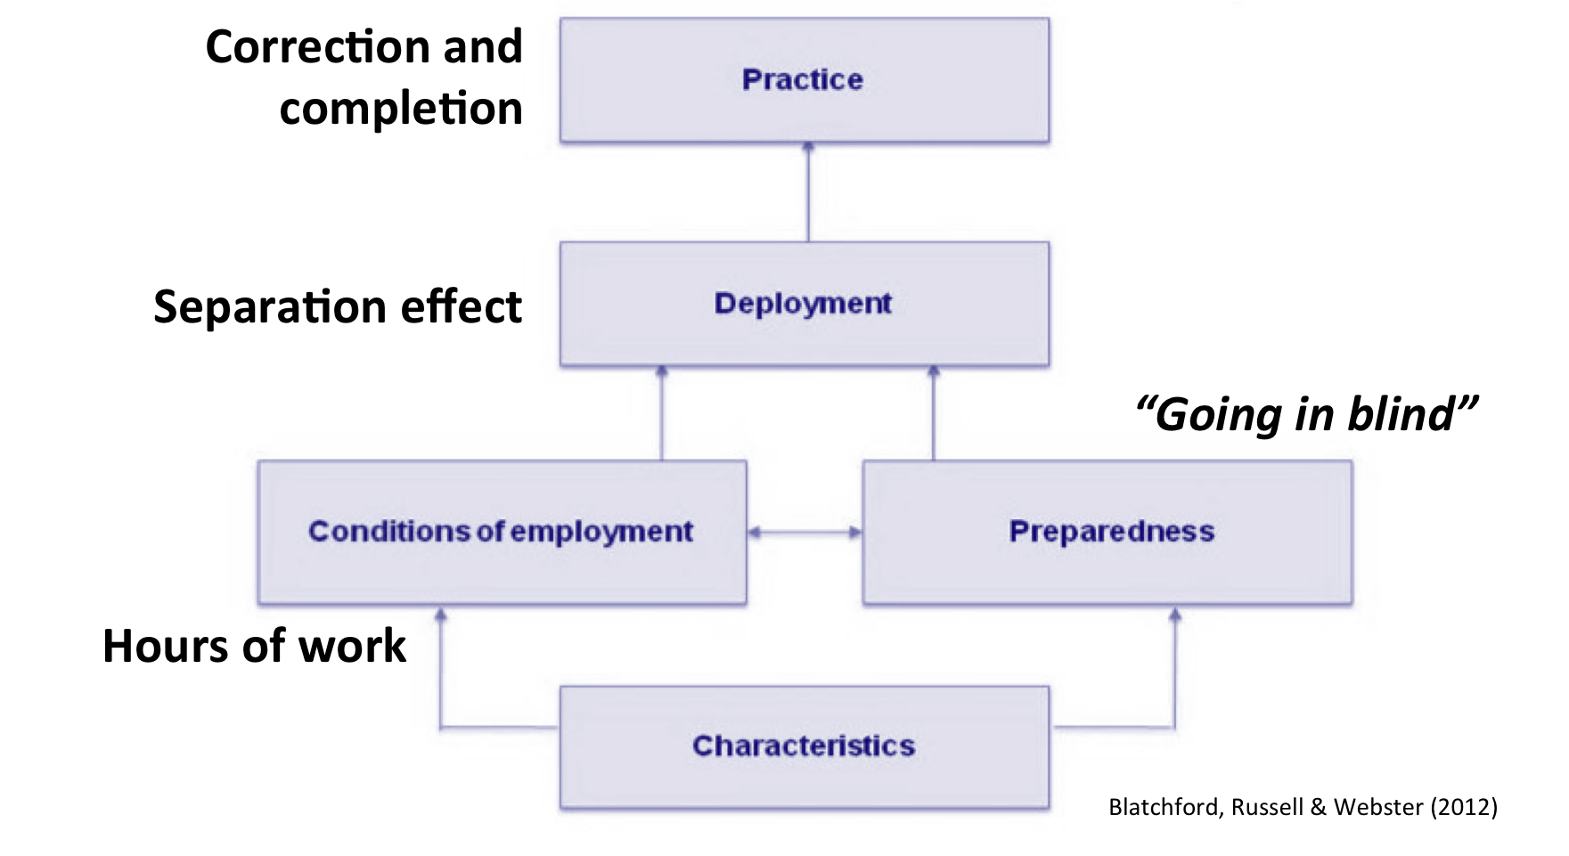
Explaining the DISS project results

Slide 7
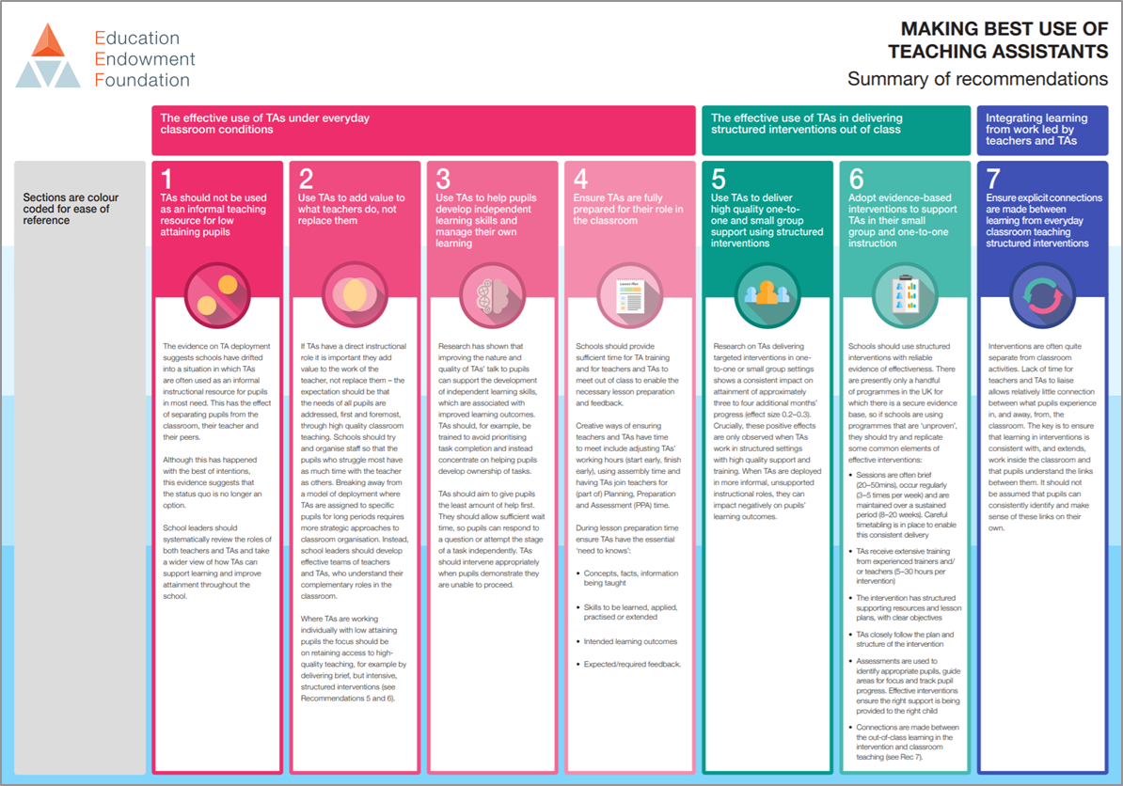
Practical, actionable recommendations

Slide 8
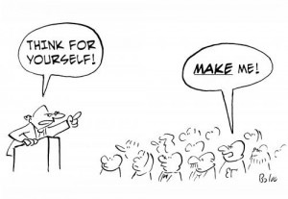
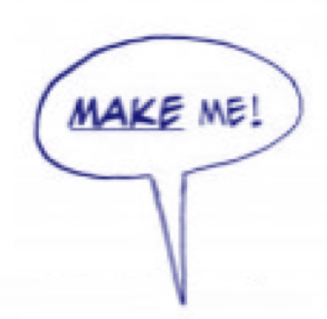
Area for action Interactions with pupils (Rec 3)
Dependency and ‘outsourcing’
Completion and correction
Stereo-teaching. Thinking time
Developing independence
Feedback and metacognition
#2 The least help first

Slide 9

Area for action: Preparedness (Rec 4)
  “There is an assumption you should just know. You come into a classroom, you listen to the 20 minutes of teaching, and from that – if you didn’t know, you should know now. And then you’re to feed it to the children. It’s scary”.
#3 Maximise the 95%

Slide 10
Three ways to think about preparation
Time for TAs during day
  Space freed up by raising expectations re pupil independence
Detailed planning
  Teachers plan lessons with TA in mind
  Role and expectations are clear
  Clarity over what teachers want fed back
Teacher-TA liaison time
  Speedy and efficient with detailed planning in place

Slide 11
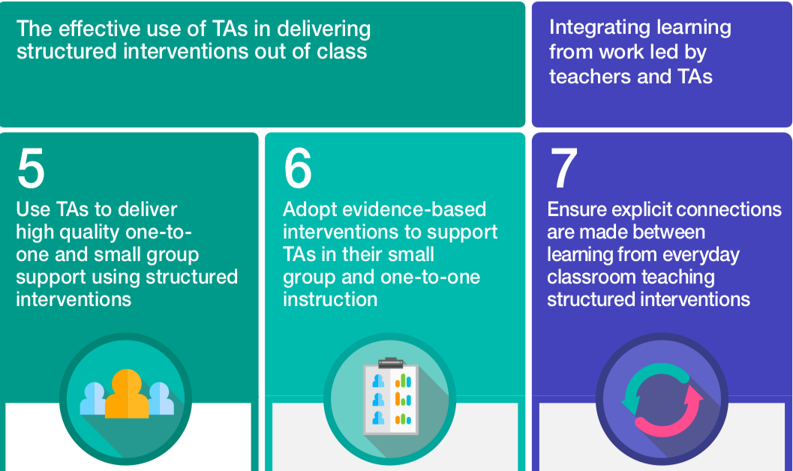
Area for action: TA-led interventions (Recs 5 & 6)
Not whether, but how

Slide 12
7 steps to better TA-led interventions
Keep up, not catch up: at least compensate for time out
Review, reject…: conduct a health-check
…and replace: slim menu, judiciously used. EEF 7
Be faithful: bake, don’t busk
Stick to the script: familiarise first, then adapt
Co-ordinate, cohere and complement: bridge the learning
Location, location, location

Slide 13
Characteristics of effective interventions
Brief (15-30mins) and regular (3-5 times per week)
Maintained over a sustained period (8-20 weeks)
Carefully timetabled; minimise time out of class
Extensive training and on-going coaching from experienced trainers/teachers. Close monitoring
Structured supporting resources and lesson plans, followed closely

Slide 14
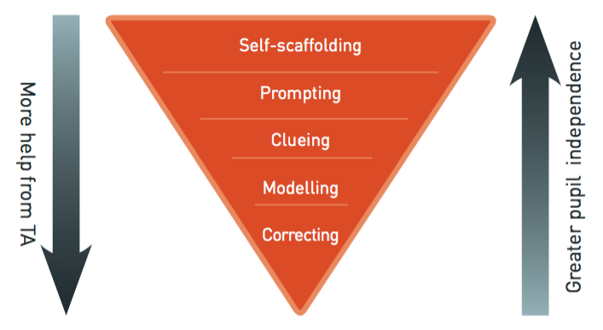
Towards improved TA-pupil interactions

Slide 15
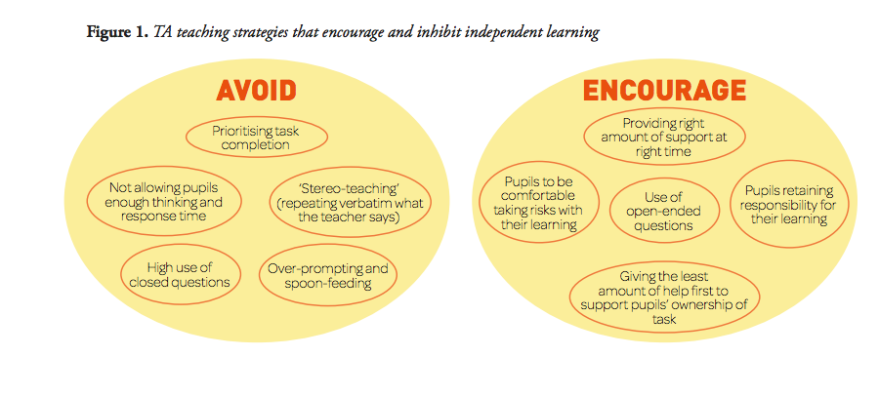

Rethinking TAs’ interactions

Slide 16
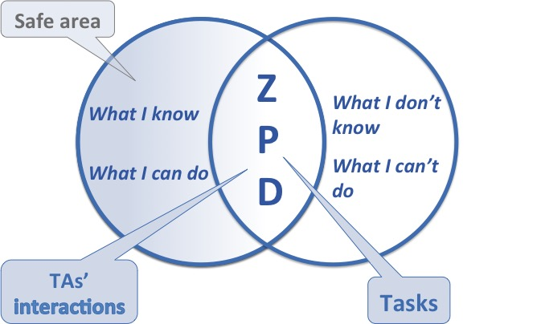
The zone of proximal development
Example: using a protractor (The TA’s Guide… p29)
How does this link to task planning by the teacher?

Slide 17
The scaffolding process
Stage 1
Student does parts of task they can do. TA provides the structure for parts the student finds challenging
Stage 2
Student attempts challenging parts using strategies learned via interaction with TA
Stage 3
Student does all parts of task independently, confidently and competently

Slide 18
TAs as expert scaffolders of learning
Scaffolding involves:
Recognising smaller learning goals
Carefully observing students’ performance
Asking questions
Providing specific prompts and clues
Providing the least amount of help

Slide 19
Why scaffolding is better than ‘help’
Greater independence
Coping with learning challenges and setbacks
Learning for learning’s sake
Accessing other adults for support
Greater opportunities for peer interaction
Less risk of stigmatisation

Slide 20
Mini-goals: process success criteria
Mini-goals break tasks down into smaller, achievable actions
Write down every step (mini-goal) required to make a cheese sandwich
Write down the process success criteria required to produce a recount text
Scaffold requires careful observation and questioning. Which mini-goal is a student on? How is he doing?

Slide 21
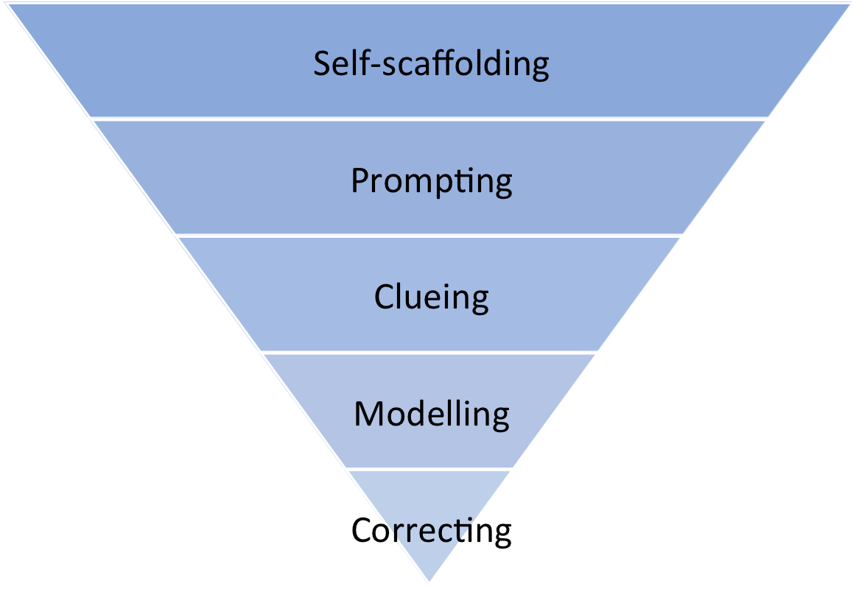
Scaffolding framework
Low TA support
High student independence
High TA support
Low student independence
pp 53-56

Slide 22

Planning how to approach a task
Listening to instructions
Taking notes
Using prompt sheets / task planners
Mind maps
Using picture boards
Developing process success criteria (mini-goals)
pp 61-62

Slide 23
Problem-solving during a task
Carefully re-reading instructions, notes or text
Using a resource
Reviewing previous work
Talking to peers
Asking the teacher. Students need to know they can do this, with encouragement and support
pp 61-62

Slide 24

Reviewing performance and strategies used
Check students’ performance against process success criteria, during and after task
Write the date
Write the title
Read the instructions
Identify what you need to do first
pp 61-62

Slide 25
Prompting
Encouraging recall of known self-scaffolding skills and development of new ones
pp 61-62

Slide 26
Prompting: wait time and silence
Ginny (reading) Here are
TA (5 second pause)
Ginny (looks at TA)
TA (smiles)
Ginny (running finger along word) ic ic icles (gives
puzzled look)
TA (7 second pause)
Ginny (moves finger to start of sentence) Here are…hanging on the
branches. (looks at picture) Oh icicles.
p 64

Slide 27
Prompting: knowing what to do when you don’t know what to do
What do you think you could do?
What is your plan?
I’m not sure. Can you remember what the teacher said?
So, you’re not sure about that word. How could you work it out?’
p 65

Slide 28
Prompting: gesture
TA And then what was this one?
Clare Then we saw (5 second pause)
TA (points at prompt sheet)
Clare (picks up a pen and writes) I remember. It was
the Banksy.
pp 65-66

Slide 29
Clueing
A piece of information or question, the answer to which helps students move on
pp 66-68

Slide 30
Clueing
Two ways of clueing:
Give a statement with information in.
E.g. The T on the protractor is important.
Ask a question, the answer to which moves them on.
E.g. What did Mr Webb do with the T on the protractor?
pp 65-66

Slide 31
Clueing
Nicole (sighs)
TA Come on Nicole. You remember sh
Nicole I remember, but
TA Shhhop. What comes first? Two letters
Nicole S H
TA Well done, sh
pp 66-68

Slide 32
Modelling
Demonstrating with commentary. Student actively listens and copies afterwards
pp 68-70

Slide 33
Golden rules of modelling
Only model the step the student is stuck on
Ease cognitive load with short, clear models
Provide commentary in the first person: ‘I am writing…’
Prime students to look and listen: ‘I want you to watch me and listen carefully so you can try it by yourself next’
Students must attempt task themselves directly after a step has been modelled. Encourage them to give it a go
pp 69-70

Slide 34
Avoid correcting
Use in exceptional circumstances
Differs from modelling, which also gives the answer
Modelling followed by student turn to demonstrate take up
pp 70-71

Slide 35

Pulling it all together

Slide 36
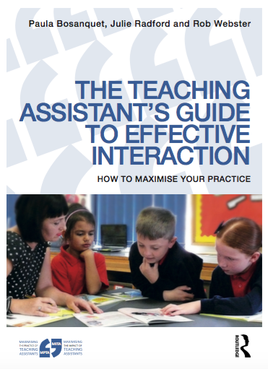


www.maximisingtas.co.uk

