Slide 1
Being an evidence informed governor
Dale Hill
Patty Williams

Slide 2
Education Research Alliance
WELL workshops
Implementation process
Effective Professional Development
Supporting Recovery
Metacognition and Self-Regulated Learning
Effective Learning Behaviours
Disadvantage Network Conference
New Teams
Middle Leaders
Marc Rowland
NNW Maths Hub

Slide 3
Our protocols
Learning with and from each other
Sharing practice, insights and experience
Putting aside distractions
Coaching each other when the time calls for it
Being prepared to ask and answer challenging questions
Maximising this opportunity

Slide 4
Session Objectives
Become familiar with ‘The EEF guide to becoming an evidence-informed school governor and trustee’.
Reflect on how your school currently uses evidence to improve outcomes for all pupils, with particular focus on disadvantaged pupils.
Understand how using evidence can help your role as a governor to support and challenge the leadership team.
Guide for governing boards | EEF (educationendowmentfoundation.org.uk)

Slide 5
Providing support and challenge
School governors play a crucial role in improving school performance by providing support and challenge to the leadership team at your school.
What are some of the barriers to doing this?

Slide 7
Evidence-informed governor
Education Endowment Foundation | EEF

Slide 8
How research evidence can help your school
Limited school budget
Capacity is stretched
Workload is a concern

Slide 9
Evidence-informed practice
Context
Professional judgement
High-quality evidence

Slide 10
Discussion time
Currently how confident are you that you know enough about your school to support and challenge your leadership team that they are making the right decisions?
What else might you need to know?
Where can you find that information from?

Slide 11
“It doesn’t matter how great an educational idea is on paper; what really matters is how it manifests itself in the day to day work of teachers.”
Sir Kevan Collins

Slide 12
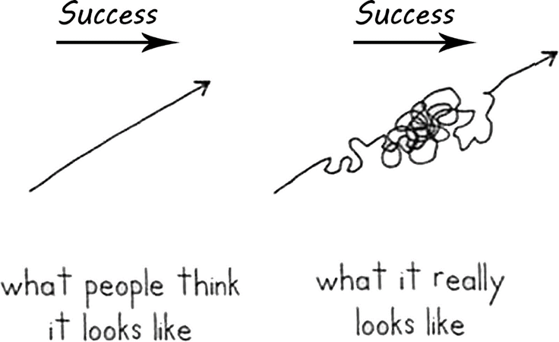
Implementation a process not an event

Slide 13
Why implementation matters
Badly implemented practices do not produce the positive changes we want to see …
… but still use up time, resources, capacity and good will

Slide 14
How well are pupils achieving in your school?
This results in a majority of 19 year-olds who have been eligible for free school meals leaving education without 5 good passes in their GCSEs, including English and maths.

Slide 15
Discussion time
Do you know how well your pupils are achieving?
Do you know how well your disadvantaged pupils are achieving?
How is data shared with your governing body?

Slide 16
How effectively is your school spending its money?

Slide 17
Personal reflection
Do you know what the pupil premium budget is for your school?
Do you know what the money is spent on and why?

Slide 18
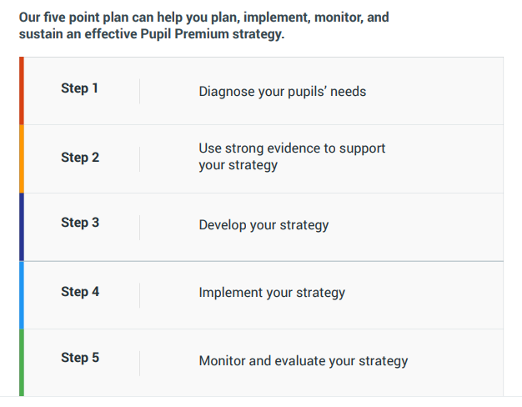
Use strong evidence to support your strategy
The EEF Guide to the Pupil Premium | EEF (educationendowmentfoundation.org.uk)

Slide 19
Menu of approaches

Slide 20
Discussion prompts
How you can support your school to plan, monitor, implement and sustain an effective strategy.
Diagnose your pupils’ needs
Use strong evidence to support your strategy
Develop your strategy
Implement your strategy
Monitor and evaluate your strategy

Slide 21
Step 1 Diagnose your pupils’ needs
Reflection questions
Are these types of questions being asked at governor meetings?
Do you feel comfortable/confident asking these questions?
What other information do you need?

Slide 22
Step 2 Use strong evidence to support your strategy
School planning support 2022-23 | EEF (educationendowmentfoundation.org.uk)

Slide 23
High quality teaching
Building teacher knowledge and pedagogical (teaching) expertise
Curriculum development
Purposeful use of assessments

Slide 24
“As with much evidence, the key message here is nuance. Principles from cognitive science are neither myths to be discounted, nor silver bullets that directly translate into accelerated progress.”
Professor Becky Francis
Chief Executive EEF

Slide 25
Personal reflection
Do you know to what extent research evidence is used to inform choices for how Pupil Premium spending is decided at your school?
How does your Pupil Premium strategy promote high quality teaching across your school?

Slide 26
Targeted academic support
One to one, small group tuition
Intensive support can support pupil learning if it is provided in addition to, and explicitly linked with, normal lessons.

Slide 27
Targeted academic support
Teaching assistant deployment
TAs should be fully prepared for their role in any lesson or intervention and their input should supplement, rather than replace, high quality provision from the class teacher.

Slide 28
Discussion time
Thinking about targeted academic support, what questions could you ask to ensure that priority pupils are being supported?
What other information do you need to know?

Slide 29
Step 4 Implement your strategy
Key questions
Are priorities aligned with other school development plans?
Does high quality teaching sit at the heart of the school’s strategy?
Does the strategy provide the necessary professional development and support for staff to implement new approaches successfully?
What is the school going to stop doing to make space (workload and budget) for additional programmes?

Slide 30
Step 5 Monitor and evaluate your strategy
Ensure your leadership team carefully monitors the impact of new programmes or approaches put in place, to check what impact they are having.

Slide 31
Reflection time
Thinking about monitoring and evaluating, how do we currently review the school’s strategies?
Do we know what the recent successes or challenges have been?

Slide 32
Summary
Know your school’s attainment gaps, and the specific challenges disadvantaged pupils face at your school.
Make closing the gap a key part of your overall school development priorities.
Understand the evidence of what works to improve teaching and learning.
Invest first in high quality teaching at your school.
Ensure the impact of new programmes is carefully monitored.
Think carefully about what the school should stop doing.

Slide 33
Perhaps most importantly
Be part of fostering a healthy leadership environment in which staff feel trusted to try new things and make mistakes, safe in the knowledge that they will be supported with high-quality resources, training and encouragement to try again and keep improving.

