Slide 1
Refreshing action research & thinking about impact for Cumbria WELL
Professor Philippa Cordingley
Bart Crisp
Centre for the Use of Research and Evidence in Education

Slide 2
Goals for today’s session
We want to create protected time for you to:
explore how our individual enquiries sit within the context of our overall question: “How (successfully) are we using evidence to inform our school’s improvement journey and work?”
connect with the learning and progress in other WELL schools to build on shared insights
explore which evidence is, or could be, most powerful in helping us lead our projects and enquiries
refine our thinking about how evidence is helping us evaluate the impact of our interventions

Slide 3
Starter activity
Think of the most powerful example of the use of evidence for enhancing pupils learning you have encountered
What was the evidence?
What did it enable?
Post your answers in the chat and we will explore them together to identify any implications for our projects/ enquiries
Now let’s repeat the cycle, this time thinking about leadership action research
Think of the most powerful example of the use of evidence for leading school improvement you have encountered
What was the evidence?
What did it enable?
What is similar and what is different?

Slide 4
Making an intervention using it strategically via leadership enquiry
The process overall involves
Designing an intervention (based on an identified need) and carrying it out
Identifying critical features of implementation effectiveness through collecting and analysing evidence focused on interactions between the intervention and the need (comparing emerging evidence to a baseline)
Reflecting on what this means for:
The future of the intervention (e.g. does the evidence suggest it can be tweaked or expanded upon?)
Wider practice across the school (including at classroom, middle leadership and policy levels) more generally
Where are we all now? Please post your stage in the chat

Slide 5
Previous use of evidence for Well action research
Pupils - assessments and pupil voice and or pupil work/books – for diagnostic, formative and summative purposes (all projects )
Teaching and learning - SLT monitoring evidence (most projects)
Teachers – notes of staff meeting discussions, surveys, coaching conversation, interviews, staff voice, (especially for outcomes evidence) (range and intensity varied)
Parents questionnaires - about half the projects
Policies - Reviews of documentation (policies, lessons plans, schemes of learning and resources) for new approaches (about a third of projects)
Making connections across evidence strands - Teacher and Leadership enquiry tools for focus pupils and more extensive use to gauge responses/ confidence changes for whole cohorts (a third of projects)
Which are you using now? Please post your answers in the chat

Slide 6
Reminder about our starting points
Here is an at a glance picture of the most commonly used evidence for ongoing school improvement in year 1:
Student progress (mainly for accountability)
Student workbooks (mainly for accountability AND professional development)
Observation notes (used for both accountability and PD by all who use it)
Student voice activities (mainly for both accountability and PD)
Feedback from SLT (mainly for both accountability and PD)
Post-training action plans (mainly for both accountability and PD)
CPD evaluation forms (used entirely for PD)
Notes from coaching/mentoring (mainly for both accountability and PD)
Which types of evidence could you use more or differently? Let us know in the chat if you used either of the base line tools

Slide 7
Reflecting on our projects
Please enter into chat:
One thing that has surprised you about the nature and/or benefits of the intervention and evidence collection you have been engaging in
One thing your experience so far is making you wonder about – a question you still would like to answer or explore
We will explore patterns that emerge from people’s answers, to split into groups where we can identify both
shared challenges and
interesting outliers

Slide 8
Transitioning from an intervention to gathering and using evidence about research informed leadership
Three key issues for action research:
What you want to learn/ discover about how your intervention is contributing to school leadership and improvement ? i.e. an enquiry question
What evidence you have & what it tells you about your question;
What you will do to draw conclusions and make strategic changes based on that evidence
The thinking and planning framework we used last time can help scaffold this – does anyone have observations about their experiences using the framework, and/or starting to develop whole-school leadership enquiry questions to share?
Please can you let us have your enquiry question and frameworks!

Slide 9
The Thinking and Planning framework
This tool is designed to:
Provide some structure for planning your action research, by describing:
the issue you are addressing with as much clarity and specificity as possible;
the change you are going to bring into effect;
how you will know what is happening as a result of your work;
what evidence you will collect to determine what has happened; and
when you will do this, with what support
Make answering these prompts as quick and simple as possible
Can be fleshed out and refined after this session, and in collaboration with colleagues
We will send out this tool right now together with the handbook

Slide 10
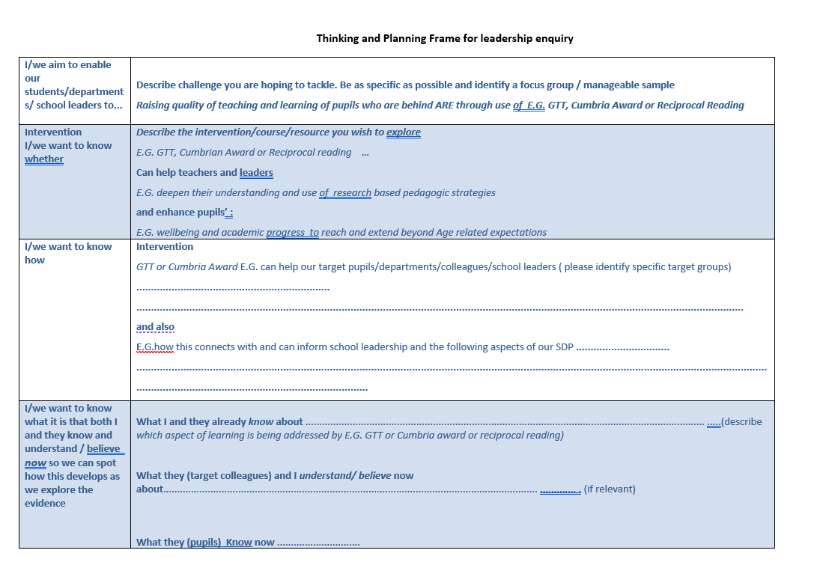

Slide 11
Staring point/ baseline | Inquiry activity spiral | Hypothesis/ theory of change to test/ explore
What are focus pupils and colleagues experiencing, saying and achieving now? Pupils are….. Colleagues are: |  | What will focus pupils and colleagues be doing/experiencing/ achieving and or not doing at the end of our project, if it is successful? Pupils and colleagues will/ will not be…
What am I/ are we doing now ? I / we are
What am I/ are we doing now ? I / we are |  | What will I/ we be doing at the end of the inquiry if it is successful? I/ we will be / not be
My initial inquiry question | My developing inquiry question and sub questions | My evidence and analysis
Gathering evidence
Innovation/ change
Analysis and reflection with colleagues/ pupils
Refining the focus

Slide 12
Next steps
Reflect on what you have learned from the intervention itself
Share your enquiry questions and frameworks with us!
Identify and/or collect evidence for your leadership enquiry question connected to the meta question about evidence informed leadership
Come to our next session ready to analyse and start to write up your reflections on further developing evidence informed leadership
Evidence to draw on might emerge from your interventions, more generally or from specific enquiries e.g.
The patterns from the circles give you an indication of a base
So would your responses to the Stoll self evaluation questions
Would doing this again with colleagues help you to identify progress?

Slide 13
Contact details
philippa.cordingley@curee.co.uk
bart.crisp@CFEY.org
Twitter @PhilippaCcuree
Twitter @crispy_bart
Twitter @curee_official
Centre for the Use of Research and Evidence in Education
Maulds Meaburn, Penrith
CA10 3HN
Tel: 01931 715886

